Slide 1
An Agile Project Management Model
Highsmith, Jim
Retrieved from Humber library

Slide 2
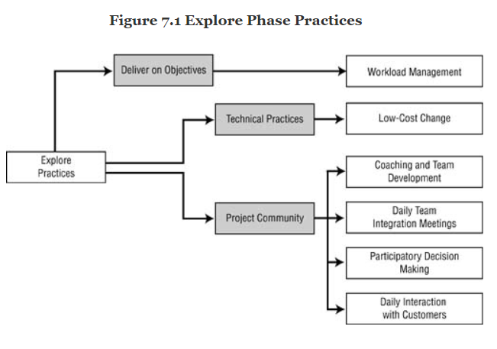
PHASE: The Explore
The Explore phase practices fall into
three categories
Deliver on Vision and Objectives
Workload management
Technical Practices
Low-cost change
Project Community
Coaching and team development
Daily team integration meetings
Participatory decision making
Daily interactions with the customer team

Slide 3
PHASE: The Explore
Practice: Workload Management. The objective of workload management is to have team members themselves manage the day-to-day activities required to deliver features at the end of each iteration.
Workload management also involves team members monitoring their own progress during an iteration (in part during daily integration meetings) and making necessary adjustments. This does not mean that the project manager or team leader abdicates his management responsibilities. When the team consistently meets its commitments, few interventions by the manager are required. However, when the team is implementing a new practice or technology, when new or less-experienced members join the team, managerial intervention—often in the form of coaching—may be necessary.
The project manager needs to monitor without micro-managing, primarily by establishing and monitoring performance goals (features, quality targets, required practices) rather than tasks. In some situations the difference between coaching and micro-managing is attitude. Micro-managers attempt to specify detailed activities and then constantly monitor whether or not those activities are completed on time. At their core, most of these managers view nonattainment of these micro-activities as a motivational problem. They believe that employees aren’t working hard enough or fast enough.

Slide 4
PHASE: The Explore
Practice: Low-Cost Change. The objective of low-cost change when applied to technical practices is to reduce the cost of iterative development throughout the development and ongoing support phases of a product.
Most technical practices are specific to the engineering domain of the product. However, there are several practices that can be applied generically to many types of products, particularly those with both hardware and software components. These generic technical practices are important to the goal of creating adaptable products—delivering customer value today and tomorrow. They are driven by the desire to keep the cost of change, the cost of experimentation, to a minimum, thereby greatly expanding the design possibilities.
The four technical practices are—simple design, frequent integration, ruthless testing, and opportunistic refactoring—also work in concert with each other. While there are many other technical practices, these four are critical to adaptability.

Slide 5
PHASE: The Explore
Technical Debt. Technical debt is the gap between a product’s actual cost of change (CoC) and its optimal CoC. As I’ve said, the twin goals of APM are delivering customer value today and tomorrow. Managing technical debt helps achieve the tomorrow goal.
For software products in particular, the actual CoC curve rises slowly at first and then accelerates rapidly after a few years. With software that has been around 10 years or more, developers are loath to touch the now “fragile” code. Constant pressure to cut the time and cost of enhancements, no allowance for periodic refactoring, and poorly maintained test data all contribute to fragility and the increased CoC—which is exemplified by companies with 10- to 15-year-old products whose QA cycles extend for a year or more. Every product, software or otherwise, has a curve such as the one in Figure 7.2, but they will have different shapes and business implications.
The bottom line is that increasing technical debt directly reduces responsiveness to customers. Customers and product managers, internal and external, don’t understand why a seemingly simple enhancement takes months and months, or even years, to implement. Yet their relentless pushing for features, features, features, faster, faster, faster is often the root cause of the problem. Without a firm dedication to long-term technical debt management, development groups are pressured into the increasing technical debt trap. As the debt gets worse, the delays become greater. As the delays lengthen, the pressure increases, usually leading to another hurried implementation, which increases the technical debt yet again.

Slide 6
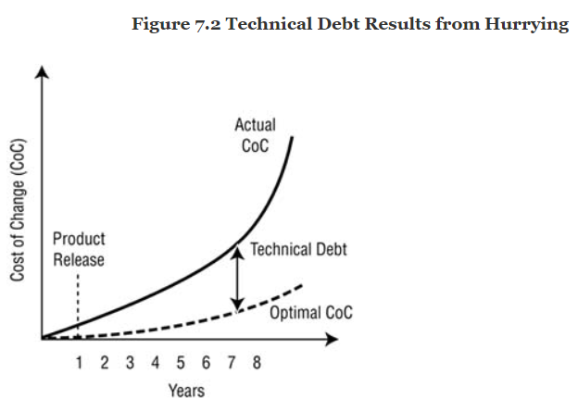
PHASE: The Explore
Exiting this downward spiral is very difficult, because the longer the technical debt cycle goes on, the more expensive it is to fix. And fixing it is a political nightmare, because after spending significant time and money, the product’s functionality won’t be any greater than before (although defects will be reduced). The bigger the debt, the more expensive it is to fix, the more difficult it is to justify, and therefore the death spiral continues.
It must be noted that managing technical debt doesn’t keep products from becoming obsolete. A technical debt strategy doesn’t attempt to stave off eventual obsolescence but to keep the cost of change low so that customer responsiveness remains as high as possible during a product’s life.

Slide 7
PHASE: The Explore
Simple Design. The objective of simple design is to keep the engineering team grounded in what is known rather than anticipating the unknown.There are two fundamental approaches to managing change—anticipation and adaptation—and good design strategies encompass aspects of both. Anticipation involves planning for the future and predicting what kinds of change are probable. Adaptation means waiting until requirements evolve or changes manifest themselves and then building them into the product. Adaptation also means experimenting, selecting those experiments with the best results, and incorporating those results into the product. The lower the cost of change, the lower the cost of experimentation, the higher the likelihood of significant innovation.
Simple design means valuing adapting over anticipating. (Anticipating or planning isn’t unimportant; it’s just less important than adapting.) This means designing for what we know today and then responding to what we learn in the future. If our objective is an adaptable product, we should be able to demonstrate its adaptability during development by responding to new information. However, the extent to which this approach is useful depends on the malleability of the medium we are working in; software is very malleable (with good design), while certain types of hardware are less so. The more malleable the medium, the lower the cost of change, the easier it will be to tip the balance of anticipation versus adaptation toward the latter.

Slide 8
PHASE: The Explore
Frequent Integration. The objective of frequent integration is to ensure that product features fit together into an integrated whole early and often during development in order to reduce both the high cost of late misalignment and the burden of testing. No matter what the product—from software to automobiles to industrial control systems—the less frequent the integration, the more susceptible the development effort will be to major problems late in the process and the more difficult, and expensive, it will be to find and fix them.
Consider some common problems with embedded software in industrial products. Hardware and software components never seem to be complete at the same time. Software engineers complain that hardware isn’t available, while hardware engineers have the same complaint about the software. While software simulations and hardware prototypes can ease the situation for some products, they can both be expensive and oversimplify real-world situations. One company that was developing the embedded software for a cell phone ran into frustrating problems with hardware test equipment from a major vendor, slowing its testing efforts. An oil-field service firm found that simulations can’t replicate all the variations of the real world, but “live” testing is also prohibitively expensive. Operating system and computer hardware developers seem to be constantly out of phase during development. At some level, integrating hardware and software will always be challenging and the problems only partially solvable. However, development teams need to strive for frequent integration to mitigate the problems.

Slide 9
PHASE: The Explore
While companies establish cross-functional hardware teams, many software groups continue to operate separately. Again, if the development approach is a traditional, up-front, anticipatory one, this functional separation seems to make sense—the software group has its requirements and just needs to go do it. But this functional separation can be deadly to effective integration of software and hardware.
Software development, can follow either a serial or an iterative approach. In the former, concept development (architecture, design, requirements) is frozen—somewhat later than the hardware development, but it essentially uses the hardware model. The agile approach, rather than attempting to limit (freeze) requirements, takes advantage of software’s flexibility by overlapping the concept development and implementation activities and thereby extends the “software freeze” until much later in the product development process. This allows the distinct possibility that late-discovered hardware flaws (or new requirements) can be implemented in software. Furthermore, the flexibility of software features, and often inexpensive throwaway features, can be used to advantage in the testing of key hardware components.

Slide 10
PHASE: The Explore
Ruthless Testing. The objective of ruthless testing is to ensure that product quality remains high throughout the development process.
In software development, ruthless testing includes software engineers performing constant unit testing, integrating quality assurance and acceptance testing into each development iteration, and having a full range of those tests automated. The ultimate goal is to produce a deployable, limited-feature product at the end of each iteration.

Slide 11
PHASE: The Explore
Opportunistic Refactoring. The objective of opportunistic refactoring is to constantly and continuously improve the product design—make it more adaptable—to enable it to meet the twin goals of delivering customer value today and in the future.
Refactoring involves updating a product’s internal components (improving the design), without changing externally visible functionality, in order to make the product easier to enhance in the future. One unfortunate legacy of serial development is the idea that reducing the cost of change depends on getting correct architectural and design decisions in the beginning. Given the constancy of change and our inability to predict those changes with any accuracy, our designs should instead be based upon what we know today and a willingness to engage in redesign in the future. Since it is inevitable that product enhancements are sometimes “bolted on” without proper design considerations, a refactoring discipline encourages teams to revisit these decisions periodically and correct them.

Slide 12
PHASE: The Explore
In order to refactor, two factors are paramount—testing and persistence. One barrier to redesign and refactoring is the risk of breaking something that is already working. We reduce that risk by thoroughly integrating testing into the development process (not tacking it on at the end) and by automating testing to the greatest extent possible. Automated testing reduces the fear of breaking something that already works.
Which brings up the second factor—persistence. For software, it means considering doing a little code refactoring every time a change is contemplated—always trying to leave the code slightly better than before. It means thinking about redesign during every development iteration and allocating some time to implement redesigns. It means planning some level of refactoring into every new product release. It means slowly, but surely, building up automated tests and integrating testing into the development process. For hardware, persistence means applying these practices to development as fully as possible, particularly for those parts of the development process that are accomplished by simulations.

Slide 13
PHASE: The Explore
Practice: Coaching and Team Development. The objective of coaching and team development is to unleash the capability of the team by helping team members continuously improve their domain knowledge (technical, business), self-discipline, and “teaming” skills.
Focusing the Team on Delivering Results - Every team member gets mired in details and forgets the goal—at least periodically. Good project managers remind the team about the goals from time to time by revisiting the key constraints and tradeoff parameters and by reinvigorating the group with the ultimate purpose of the project. This is part of encouraging exploration, which might be considered a leader’s cheerleader role, but it’s one that must be based in reality rather than fantasy. Team members want a boost every now and then, but they don’t want meaningless rah-rah speeches. Team members want the facts, even negative ones, so they can help figure out how to deal with the situation.
The manager helps the team focus on both the overall goal of the project and the iteration themes. This may appear to be an easy task, but with the high rate of change and the pressure to deliver quickly, the task is a difficult—and constant—one.

Slide 14
PHASE: The Explore
Molding a Group of Individuals into a Team. Teams with little trust interact on only a superficial level. Lack of interaction fosters a focus on individual rather than team goals. Unsatisfactory conflict resolution reduces trust. Win-lose decision making undermines people’s commitment to the team.
Trust enables team members to share half-baked ideas without the fear of ridicule. Trust and respect are also closely tied together—it’s difficult to respect those we don’t trust, and vice versa—which is one reason that getting the wrong people on the team can have such a detrimental effect. Respect comes from understanding other people’s roles on a project. Engineers need to understand how product marketing contributes to project success, and product marketing likewise needs to acknowledge engineering’s contribution. Frequent interactions help generate understanding, which in turn can lead to respect and trust.
Interaction drives innovation. One of the tenets of adaptive organizations is that innovation emerges from the interaction of diverse individuals, each with ideas, who bring information and insight to the development process. Product development projects usually involve teams whose members possess a complex mix of information and talents. Engineers, product specialists, and scientists from diverse domains must consolidate their expertise into a consistent, high-quality product design. To accomplish this goal, individuals balance time alone to develop their particular piece of the product puzzle with face-to-face time with others to fit the pieces together. When team members don’t interact, there is no synergy of ideas, and innovation suffers. Interaction can take many forms (brainstorming sessions, hallway chats, technical design reviews, online group discussions, and, in the software world, pair programming), but the objectives are the same: to share information, to co-create a product feature or development artifact, or to make a joint decision about an issue. Project managers must encourage this peer-to-peer interaction, particularly as pressure mounts and individuals have a tendency to “go dark.”

Slide 15
PHASE: The Explore
Rules of engagement are not meant to reduce conflict and contention but to direct them in positive ways. Great teams froth with tension, contention, and diverse ideas directed at delivering a high-quality result. Poor teams froth with tension, contention, and diverse ideas directed at each other. These team norms can include such rules as:• Everyone has an equal voice.• Everyone’s contribution is valuable.• Attack issues, not people.• Keep privacy within the team.• Respect each other and your differences.• Everyone participates.

Slide 16
PHASE: The Explore
Developing Each Individual’s Capabilities.
Individuals contribute by applying their technical skills and engaging in team-enhancing (self-organizing) behavior. This self-disciplined behavior includes:• Accepting accountability for results (no excuses)• Confronting reality through rigorous thinking• Engaging in intense interaction and debate• Being willing to work within a self-organizing framework• Respecting colleagues

Slide 17
PHASE: The Explore
Providing the Team with Required Resources and Removing Roadblocks.
Project managers also remove roadblocks that impede the team from working efficiently. For example, project managers need to quickly and effectively resolve impediments that are voiced in daily team integration meetings. Roadblocks can be things such as resources (the team doesn’t have them), information (the team can’t get it from a customer), or decisions (a stakeholder manager hasn’t made them in a timely fashion).

Slide 18
PHASE: The Explore
Coaching the Customers.
The fundamental problem is a poor customer-developer partnership caused by one of any number of factors:• Development’s lack of credibility in the eyes of customers• Lack of customer involvement• Poor accountability on the customer’s side for making decisions and accepting the consequences• Long development schedules, exacerbated by delivering meaningless (to the customer) intermediate artifacts• Unrealistic project schedules based on poorly articulated requirements• Lack of acceptance criteria and testing by customers.
With a product manager appointed from the customer ranks, many problems are lessened because the customers, through the product manager, must accept accountability for identifying, defining, prioritizing, and accepting features. One of the product manager’s jobs is to coach the customer team through this process. For industrial or consumer product development projects, the product manager has to work with (coach) internal “proxy” customers—marketing, executives—as well as gain information about the external customer base through periodic customer involvement, beta testing, and other means.

Slide 19
PHASE: The Explore
Orchestrating Team Rhythm. Agile projects are rhythmic, not linear. Furthermore, there are rhythms within rhythms, which makes describing agile projects difficult to those who are used to seeing linear project task plans. There are the rhythms of iterations, which alternate between intensity and reflection as teams work to deliver features and then pause to reflect on the results. There is the rhythm of daily integration meetings and interactions with customers on feature details. There is the rhythm of peer-to-peer interaction as engineers meet at whiteboards to thrash through a design before retreating to more private reflection and work. There is the rhythm of constantly thinking, designing, building, testing, and reflecting on small increments of work. There is the rhythm of anxiety and euphoria as people try to solve, and then succeed in solving, seemingly intractable problems.

Slide 20
PHASE: The Explore
Practice: Daily Team Integration Meetings. The objective of daily team integration meetings is to coordinate team member activities on a daily basis.
The daily integration meeting enables the team members to coordinate their work by monitoring status, focusing on the work to be done, and raising problems and issues. The meetings adhere to the following principles:• The meetings are held at the same time and place every day.• The meetings last less than 30 minutes (the target should be 15 minutes or less).• All core team members attend the meetings.• Product and project managers attend as peer participants (not to gather status).• Other managers usually do not attend these meetings, and if they do, they are observers, not participants.• A team member or the project manager facilitates the meetings.• The meetings are used to raise issues and obstacles but not to pursue solutions.• Each participant is encouraged to address three questions: What did you do yesterday?• What are you planning to do today?• What impediments are in the way?

Slide 21
PHASE: The Explore
Time duration is critical to meeting success. When daily meetings begin to slide past 20 to 30 minutes, people gradually stop coming. Even worse, lengthening timeframes are a sure indication that the wrong things are being discussed. For example, these meetings should not be used to solve problems, only to identify them. Usually, when problems are identified, the team members involved in the solution get together briefly after the integration meeting.
The project manager’s participation is another delicate factor in successful integration meetings. The objective of these meetings is coordination, not status review. When managers begin asking questions like “Why didn’t that task get finished as planned?” team members feel pressure, sometimes subtle, sometimes not so subtle, to conform to the plan rather than discuss coordination issues. The astute PM rephrases the question to uncover impediments to progress and find out what team members need from him to get back on track. Task performance pressure in these integration meetings should come from peers, not from managers.

Slide 22
PHASE: The Explore
Other adaptations can be made for projects with multiple subteams or feature teams. Integration meetings can be used to coordinate across these feature teams, with appropriate adjustments. For example, in a project with four feature teams, two members of each team might attend a thrice-weekly inter-team integration meeting. During times of greater coordination needs—say, at the beginning of a project when overall design issues are being discussed—inter-team meetings might be daily, while later on they might be weekly.
Finally, the team should constantly ask questions (especially at milestone reviews) like: “Are these daily team integration meetings adding value to the project?” and “How could we improve them?” The objective of these sessions is coordination, not having daily meetings or answering the three questions (accomplished, planned, impediments) for their own sake. Those activities merely facilitate achieving the objective.

Slide 23

PHASE: The Explore
Practice: Participatory Decision Making. The objective of participatory decision making is to provide the project community with specific practices to frame, make, and analyze the myriad decisions that arise during a project.
No doubt decision making is hard, but it is made harder than necessary by poor practices. While “rational” decision making may be a fantasy, there are practices that can assist project teams in making better, implementable decisions. Three elements compose a decision process: decision framing, decision making, and decision retrospection. Framing establishes “who” gets involved in the process, while decision making establishes “how” the “whos” go about making a decision. Retrospection provides feedback into the decision-making process. As with other APM practices, decision-making practices must be implemented with the Simplify principle in mind; otherwise the team will end up with just another unwieldy set of procedures and forms.

Slide 24
PHASE: The Explore
Decision Framing. The intent of the often overused term “empowerment” is to delegate decision-making authority to lower levels of organizations by changing who makes decisions. Decision framing focuses on who gets involved in the decision process. Managers who make decisions without input from subordinates and peers make poor decisions. Engineers who make decisions without input from managers and peers make poor decisions. Who makes the decision is less important than getting the right people involved in the decision process.
Projects should include a defect triage decision framework, which is basically asking and answering the question, “Is this product ready to release?”For each decision type, typical framing questions are:• Who is impacted by the decision?• Who needs to provide input to the decision?• Who should be involved in the discussions about the decision?• Who should make the decision (the product manager, the project manager, the project team, the project manager with the team, etc.)?• What decision criteria should be used?• How and to whom should the decision results be communicated?• Who should review the decision?

Slide 25
PHASE: The Explore
Decision Making. There are two objectives against which any decision-making process must be judged. First, does the process result in the best choice given the circumstances in which the decision was made? Second, was the decision implemented? As many project managers have found out the hard way, making and implementing decisions are two different things. How many times have you encountered decisions made within the confines of a conference room that fall completely apart when the participants walk out the door? Anyone can make a decision, but effective managers grasp that implementation requires people to understand and support the decision.
A participatory decision-making process has three components: principles, framework, and practices. The fundamental principles have just been alluded to: viewing the process as a win-win process and treating all participants with respect. All collaborative practices are based on trust and respect, or perhaps more precisely, on building trust and respect. Kaner’s diverge-groan-converge model provides a framework for building these positive relationship qualities. In the diverge-groan-converge framework, the transition from the divergent zone to the convergent zone explains how team members move from having individual opinions to having a unified position. At first, people’s ideas diverge. Even though each person wants to contribute to success and to making a quick decision, each wants to voice his or her own opinion. Everyone has a different perspective or a different experience, which brings needed diversity to the decision process but not much agreement. This groaning period takes time, time for people to speak and hear, time for them to build trust. A little extra time (it’s not really extra, but it seems as if it is) taken on decision making in the early stages of a project will significantly reduce time as the project continues.

Slide 26
PHASE: The Explore
The transition period between divergence and convergence, the groan zone, is the time during which team members groan and complain. In the divergent zone, most group members voice their opinions to make sure the group hears their ideas. Much of this time could be considered presentation, during which members are less concerned with understanding each other than with selling their own ideas. Participants begin to groan because they are trying to understand one another, and understanding requires thought. It is relatively easy to take a position and argue for it. It is much more difficult to attempt to understand why other participants hold their opinions. Participants want to ask questions, they want to be heard, they want to—participate. The groan zone provides a perfect description of what happens in most teams; it is a turbulent zone where innovative, creative results are generated.

Slide 27
PHASE: The Explore
This non-unanimous type of consensus is built on the following premises:• Everyone has had an opportunity to have his or her ideas heard and discussed.• Consensus does not imply unanimous agreement, but it does mean that people understand the decision rationale.• No one has been silenced due to fear or intimidation.• The preponderance of the group votes in favor of the decision (or in favor with some reservations).• No one vetoes the decision (instead, they disagree and commit).
Different kinds of decisions require different decision criteria. Coin flipping works for what time to go to lunch. The tradeoff matrix steers high-level decisions, just as performance criteria might steer technical decisions. Release decisions might use certain quality criteria. For each kind of decision, one of the discussion topics should be the criteria to be used in making that type of decision. You may even need to go through a decision-making process to arrive at the criteria for making a decision.

Slide 28
PHASE: The Explore
Decision Retrospection. End of iteration, milestone, and project retrospectives should include time to review decisions within the context of reviewing the team’s performance (which I discuss in the next chapter). However, if project retrospectives are difficult to do in general, then decision retrospectives border on the impossible, because finding whom to blame often seems more important than learning. But how do we get better at decisions unless we understand which ones worked out well and which ones didn’t?
We are sometimes our own worst enemies. In the medical profession, for example, airing mistakes is especially difficult because of the threat of medical malpractice suits. Sharing and learning from decisions become severely inhibited; therefore, the same mistakes are repeated by other doctors or other hospitals because little retrospection occurs. A recent television program described an initiative in the northeastern United States in which this veil of secrecy was lifted in a concerted and collaborative effort between doctors and hospitals. Not surprisingly, problems decreased.

Slide 29
PHASE: The Explore
Leadership and Decision Making. A good project manager has to be a visionary, a teacher, a motivator, a facilitator, and other things, but she must also be a decision maker. The same is true of chief engineers for technical issues. So the question becomes, at what point does a manager’s decision making damage self-organization? First, when the team loses respect for the leader. But what causes loss of respect? The answer: when the manager begins making unilateral decisions. The more unilateral decisions, the less participation from the team, the less likely the decisions are to be effectively implemented.
Good leaders have earned the credibility to make these decisions. The technical staff respect the leader’s judgment (based on previous actions taken), participate in the analysis and debate process, and willingly accept the decision in order to move on. The leader has absorbed the ambiguity of the situation, whereas leaving the decision to consensus would have bogged the project down in interminable debate. Good leaders know when to step in and take charge and when to encourage the team to take charge. They also know when to dig into why team decision making isn’t working as it should.

Slide 30
PHASE: The Explore
Set- and Delay-Based Decision Making. Unlike point requirements, set-based requirements focus on ranges or minimum constraints. So the body design group would impose a criteria “range” on the exhaust system, keeping the tolerances as broad as possible in the beginning and narrowing them over time as the car approaches manufacturing. As the body design and exhaust system designs evolve, engineers are more likely to balance subsystem optimization with overall vehicle optimization. In a point-based approach, each subsystem team has a tendency to quickly create optimized designs for its particular subsystem that are often at odds with overall system design effectiveness.

Slide 31
PHASE: The Explore
Practice: Daily Interaction with the Customer Team. Daily interaction with the customer team, which includes the product manager, helps ensure that the development efforts stay on track to meet the needs and expectations of the customer.
In both general business and product organizations, individuals often blanch at the prospect of daily interaction with development teams. As I noted earlier, product managers often wear two hats—an external marketing hat and an internal product development one. Unfortunately, the external demands often override the internal ones, and time with the development team suffers. When exploration factors are lower and development teams possess product domain knowledge, the project might not suffer as much from lack of interaction between the customer and development teams, but when exploring uncertainty prevails, this interaction is vital to ultimate success. Feedback is critical to exploration because, without it, experiments veer off into costly and unproductive directions.

Slide 32
PHASE: The Explore
Stakeholder Coordination. Another project manager responsibility is stakeholder coordination. Project managers must secure resources and ensure ongoing support for the team. A project team may need a component from another team or an external supplier. The accounting department may need periodic information. Executives may need to be briefed on the progress of the project. Project managers who don’t identify each stakeholder and initiate a coordination plan to ensure that each one gets the service he or she needs from the team run the risk of getting blindsided by a disgruntled stakeholder. Some stakeholders contribute to the project’s success, and others can be serious impediments—but they all have to be managed. While members of the project team can assist, managing up and out is generally the responsibility of the project manager, who must shelter the team from the sometimes crazy politics of stakeholder coordination.

Slide 33
PHASE: The Adapt and Close
Adaptations can take many forms. A team that rushes to deliver features but creates defects—hurrying rather than being quick—needs to adapt its behavior. A creeping design degeneration gives rise to additional “refactoring” activity in the next iteration. Cost overruns are highlighted by the project status review, and appropriate action is taken.
Reacting to events is more difficult than reacting to a plan, because the team has to answer three critical questions:• Are customers getting value from the project?• Is the project progressing satisfactorily?• Is the project team adapting effectively to changes imposed by management, customers, or technology?

Slide 34
PHASE: The Adapt and Close
“Are customers getting value from the project?” In an agile project, because of changes over the course of an iteration, teams need to continually review the product’s value. The customers and product manager make frequent adjustments in the feature priorities based on their interpretation of feature value. Measuring value can be difficult, more difficult than measuring cost or schedule against plan, but without a constant attention to determining value—if only an implicit customer ranking rather than an explicit numerical calculation—guiding an agile project will prove difficult. The product manager needs to assess whether the value generated during an iteration was worth the cost of development.“
Is the project progressing satisfactorily?” This question is also more difficult to answer than whether the project is conforming to plan. Conformance to plan is one aspect of satisfactory progression, but only one. Members of the project team must ask themselves the question, “Given the circumstances during the last iteration, did we make sufficient progress, and what additional information did we learn?” Progress can be measured in a variety of ways depending upon the project. For large projects, especially those involving government contracts, a form of earned value analysis (with value calculated from features completed) may be appropriate. For smaller projects, a simple graph of features completed by iteration should suffice.“
Is the project team adapting effectively to changes imposed by management, customers, or technology?” As requirements evolve, staff changes take place, component delays occur, and a multitude of other things impact a project, the team members need to assess how they are adapting to those changes. Also, if managers and executives want project teams that can be flexible and adapt to change, then they must give teams appropriate credit for that flexibility. When a team deviates from the original plan but effectively responds to a surprise product release from a competitor, that team should be evaluated on the situation and their response, not the outdated plan.

Slide 35
PHASE: The Adapt and Close
Practice: Product, Project, and Team Review and Adaptive Action
The objective of the review and adaptive action practice is to ensure that frequent feedback and high levels of learning occur in multiple project dimensions.
There are two main reasons for conducting review and adaptive action sessions at the end of an iteration or milestone. The first reason is obvious—to reflect, learn, and adapt. The second is more subtle—to change pace. Short iterations give a sense of urgency to a project because a lot has to happen in a few weeks. Team members work at a quick pace, not hurrying, but working quickly at a high level of intensity. The end-of-iteration review period should be more relaxed, a brief time (normally a day or so) in which the team reflects on the last iteration and plans ahead for the next. Most teams need this break in intensity periodically to gather their energy for the next iteration. During this reflection period, four types of reviews are useful: product functionality from the customer team’s perspective, technical quality from the engineering team’s perspective, team performance checkpoints, and a review of overall project status.

Slide 36
PHASE: The Adapt and Close
Customer Focus Groups. Customer focus group (CFG) sessions demonstrate ongoing versions of the final product to the customer team in order to get periodic feedback on how well the product meets customer requirements. While CFGs are conducted at the end of iterations and milestones, they should be scheduled at the beginning of the project to ensure the right participants are available at the right times.
The definition of acceptance testing varies by industry, but in general CFG reviews provide a wider focus than acceptance testing. Acceptance testing concentrates on system behavior related to critical engineering design parameters, while CFGs focus on how the customers use the product. CFG reviews gather feedback on look and feel, general operation of the product, and the use of the product in business, consumer, or operational scenarios. For example, a specific acceptance test could measure the heat dissipation of an electronic instrument, or a software acceptance test case might ensure a business rule is properly calculated. Running exhaustive engine, electronic, and hydraulic tests to check predetermined values would be part of an airplane’s acceptance testing. Actual flight testing—testing the product under conditions of actual use—would be similar to a CFG.

Slide 37
PHASE: The Adapt and Close
CFG review sessions:• Should be facilitated• Should be limited to eight to ten customers (Development teams are present but have limited involvement; they are primarily observers.)• Review the product itself, not documents• Focus on discovering and recording desired customer changes, but not on gathering detailed requirements (if, for example, new features are identified)
Technical Reviews
One of the key principles of exploratory, agile projects is to keep the cost of iteration low (both during development and after first deployment) such that the product itself can adapt to changing customer needs. Keeping the cost of iteration low and adaptability high depends on unceasing attention to technical excellence. Poorly designed, poor-quality, defect-prone products are expensive to change and therefore inflexible to changing customer demands. When customers buy a $500,000 biomedical device, they want it to respond to future needs (within limits) quickly and cost effectively. Often, the flexibility of industrial products, such as a biomedical device, depends on the flexibility of its embedded software.

Slide 38
PHASE: The Adapt and Close
Technical review sessions:• Are facilitated• Are generally limited to two to six individuals who are competent to evaluate the technical material• Review the product, selected documents, and statistics, such as defect levels (The technical team should take time to reflect on the overall technical quality of the product and make recommendations about refactoring, additional testing, more frequent integration, or other technical adaptations.)
Team Performance Evaluations.
A fundamental tenet of APM is that projects are different and people are different (and thus teams are different). Therefore, no team should be shoehorned into the same set of processes and practices as another. Project teams should work within an overall framework and guidelines (such as this APM framework and its associated guiding principles), but they should be able to adapt practices to meet their unique needs. Self-organizing principles dictate that the working framework should grant the team as much flexibility and authority to make decisions as possible. Self-disciplinary principles dictate that once the framework has been agreed upon, team members work within that framework. Assessments of team performance should touch on both of these factors.

Slide 39
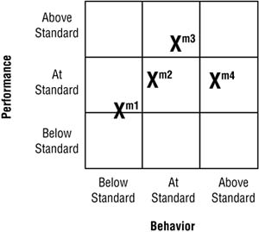
PHASE: The Adapt and Close
The information shown beside (team self assessment chart for each milestone) can be used as a starting point for evaluating team performance. The team evaluates itself in two dimensions—delivery performance and behavior—on a three-point scale: below standard, at standard, or above standard. On delivery performance, the team members are asking themselves the fundamental question, “Did we do the best job we could do in the last iteration?” Notice that the question isn’t related to plans but to the team’s assessment of its own performance. Whether teams conform to plan or not depends on both performance and the accuracy of the plan (so one piece of this evaluation might be for the team members to assess how well they planned the iteration). A team could meet the plan and still not be performing at an optimal level. In a well-functioning team, members tend to be open and honest about their performance. The team discussion, not the assessment chart itself, is the important aspect of this exercise.

Slide 40
PHASE: The Adapt and Close
The second aspect of the evaluation is team behavior, in which the team, again, assesses its own performance. This evaluation involves answering the questions, “How well are we fulfilling our responsibilities?” and “How well is the organization fulfilling its responsibilities?” Answering these two questions could generate a raft of other questions, such as:• Are all team members participating in discussions?• Is someone regularly absent from daily meetings?• Are team members being accountable for their commitments?• Is the project manager micro-managing?• Does the team understand how and why key decisions were made during the last iteration?

Slide 41
PHASE: The Adapt and Close
Project Status Reports.
Project status reports should have value to the project manager, the product manager, key stakeholders, and the project team itself. The reporting of information should drive activities aimed at enhancing performance. Developing the reports should help the project and product managers reflect on the overall progress of the project—to separate the forest from their daily battle with the trees. The number and frequency of reports and the information in the reports need to match the size, duration, and importance of the project.
Part of the project manager’s job involves managing stakeholders, particularly those in upper management, and providing information to them. What stakeholders ask for may be very different from what is needed to manage the project, but the project manager neglects this other information, and periodic interactions with those stakeholders, at her peril. Managing the expectations of various stakeholders can be a delicate balancing act.

Slide 42
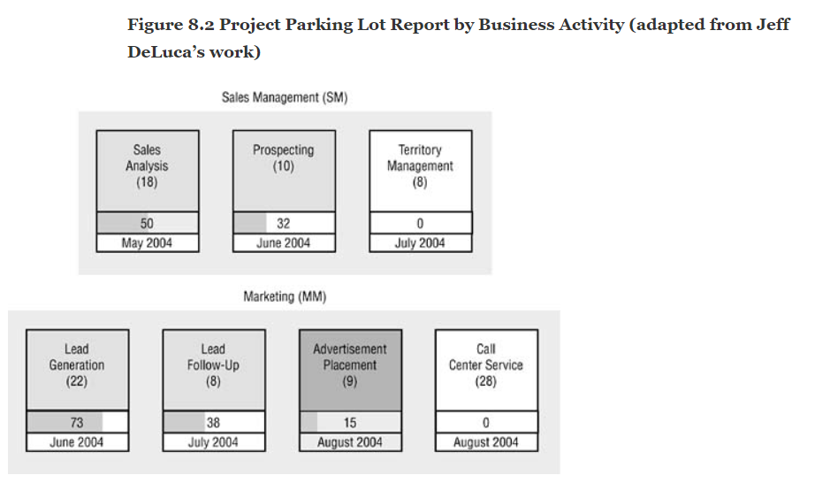
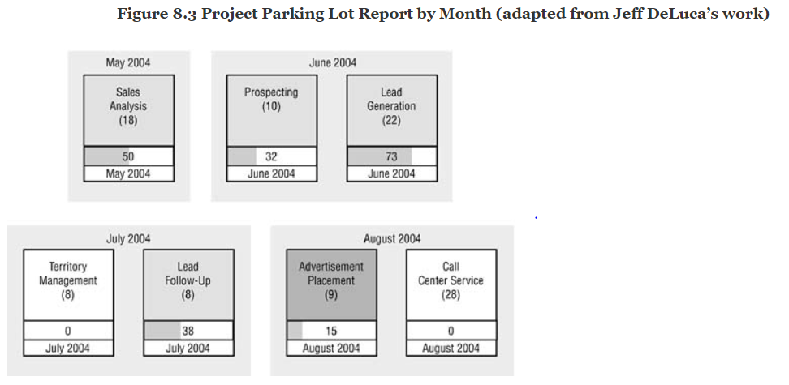
PHASE: The Adapt and Close

Slide 43
PHASE: The Adapt and Close
Scope and Value Status.
Scope tells us the raw volume of feature deliverables, but not how valuable they are. Since the objective of agile development is to deliver high-value features early, in some cases to achieve early ROI, then one potentially beneficial report is “features and value delivered,” as shown in Figure 8.5. For this report, the customer team needs to apportion the product’s value to individual features or to the broader level of a component or business activity.
For a simple value assessment, the customer team can rank order features using an informal value assessment and then indicate its satisfaction with the delivered features from each iteration on a five-point scale, as shown (in combination with a technical quality assessment) in Figure 8.6. Finally, as systematic risk and uncertainty reduction is a strong indicator of increasing value, a technical risk and uncertainty assessment, as shown in Figure 8.7, can be beneficial.

Slide 44
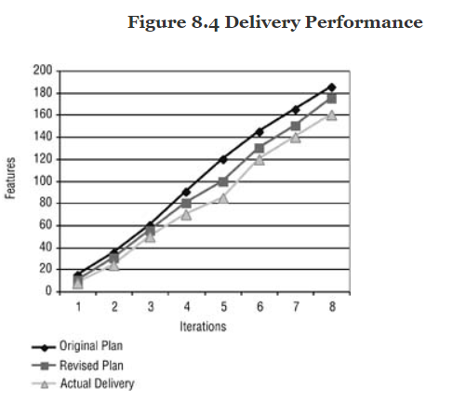
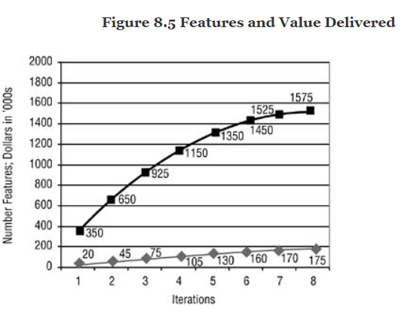
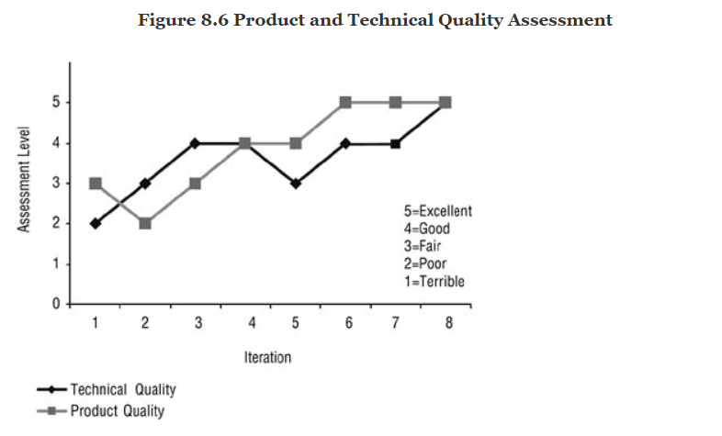
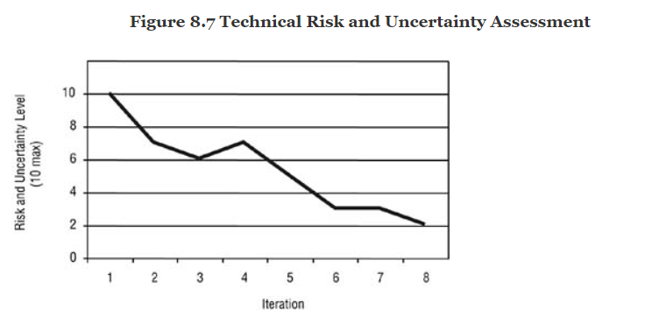
PHASE: The Adapt and Close

Slide 45
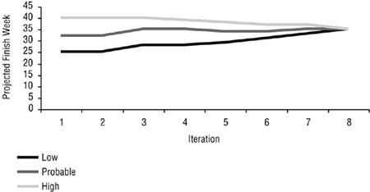
PHASE: The Adapt and Close
Schedule Status.
Schedule reports can take a variety of shapes depending on the organization’s standard practices.

Slide 46
PHASE: The Adapt and Close
Cost (Resource) Status
Cost reports can also take a variety of shapes depending on an organization’s practices. Although accounting reports are outside the scope of this book, one key number that many managers watch is expected cost to complete, which on an agile project should be calculated at least once per month.
Quality Status
As with other project measurements, there are a wide range of quality metrics, many of which are product dependent. One important aspect of quality is a team’s assessment of its work, as shown in Figure 8.4. Given the results of technical reviews, defect reports (e.g., find and fix rates), and the team’s sense of the project’s “feel” or “smell,”6 this chart plots the level of technical quality—as assessed by the team—each iteration. Another example of a quality measure in software development is the growth of test code compared to executable code—both should be growing proportionally.

Slide 47
PHASE: The Adapt and Close
Adaptive ActionAs mentioned earlier, the term “adaptive action” conveys a sense of responding rather than correcting. In answering the three questions on value, progress, and adaptation posed in the beginning of this chapter, there are three further detailed questions to be asked: Where are we? Where did we plan to be? Where should we be? Adaptive actions run the gamut, from minor tweaks to the next iteration’s planned features, to adding resources, to shortening the project’s schedule (with appropriate feature adjustments). Adaptive adjustments can impact technical activities (e.g., allocating more time for refactoring) or modify delivery processes to make them more effective. Any of the four review types—product, technical, team, project status—can result in adaptive actions.

Slide 48
PHASE: Close
A project close is both a phase and a practice. Organizations have a tendency to spend too much time initiating projects and too little time closing them. During a client engagement, I encountered the “failure to close” problem again. The customers of an IT project considered IT delivery to be less than stellar, partially because they thought the project had been underway for years. In reality, the application in question had been installed for several years, but the initial production and ongoing enhancement releases were not differentiated from each other. So from the client’s perspective, the “project” just went on and on.
Since resources are always scarce, people are moved on to the next project quickly, often without taking time to close up the last project and get credit for its completion. There are several activities involved in closing a project, most of which don’t take much time but do pay off. First and foremost is a celebration. A celebration serves two primary purposes. One, it shows an appreciation for all those who worked hard on the project. Including key clients in the celebration helps declare that this project is over, done, finalized, thus providing a sense of closure. Projects that go on and on without closure (or a series of projects couched as one) are terrible for morale.

